Slide 1

Insight into Francisella tularensis-erythrocyte interactions
Department of Biological Sciences, West Liberty University, West Liberty, WV, 26074
Luke D’Cunha, Stuart Cantlay & Joseph Horzempa
Notes:
Need more practice, at least 3 times, and record self on zoom. And watch it back, and practice tomorrow. Set up next slide, before we switch over to, so it flows better.

Slide 2
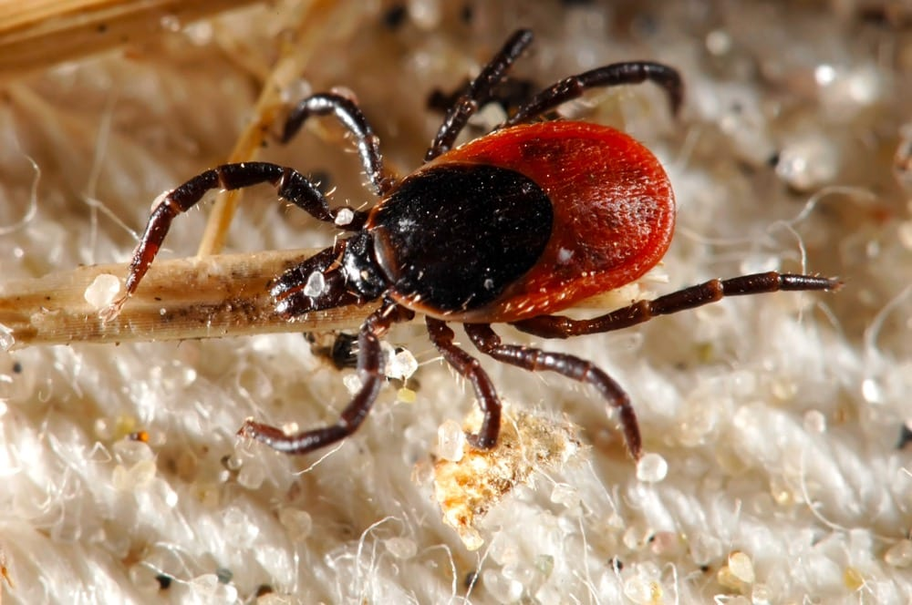
Francisella tularensis Overview
Causative agent of tularemia
Category A Select Agent, Bioweapon
Gram-negative, aerobic, facultative intracellular, coccobacillus
Arthropods natural vector
Replicates in host macrophages
Invades RBCs
Notes:
Invade RBCs is unique
Invade lots of cells in human body, arthropods natural vector, ticks in NA, mosquetoe in Europe
Transmission rate by francella by tick. Ticks are second most frequent mode of transmission in US, top mode of transmission is hunting. Have a slide to clarity infection of macrophages and RBCs. Maintiny francella infects macrophages, so mention this. RBC invasion is a novel mechanism, so mention macrophages also. Include this macrophage information in this backfround sidea diagram of regular invasion, and contrase it against RBC invasion.
Mention that it was Dr. Horzempa that found these out, so that is why research is coming from Horzempa lab. Lazer pointer, good to use and point out tick, explain to viewers why you are showing picture of tick, whenever you show a picture, draw audience attention to it.

Slide 3
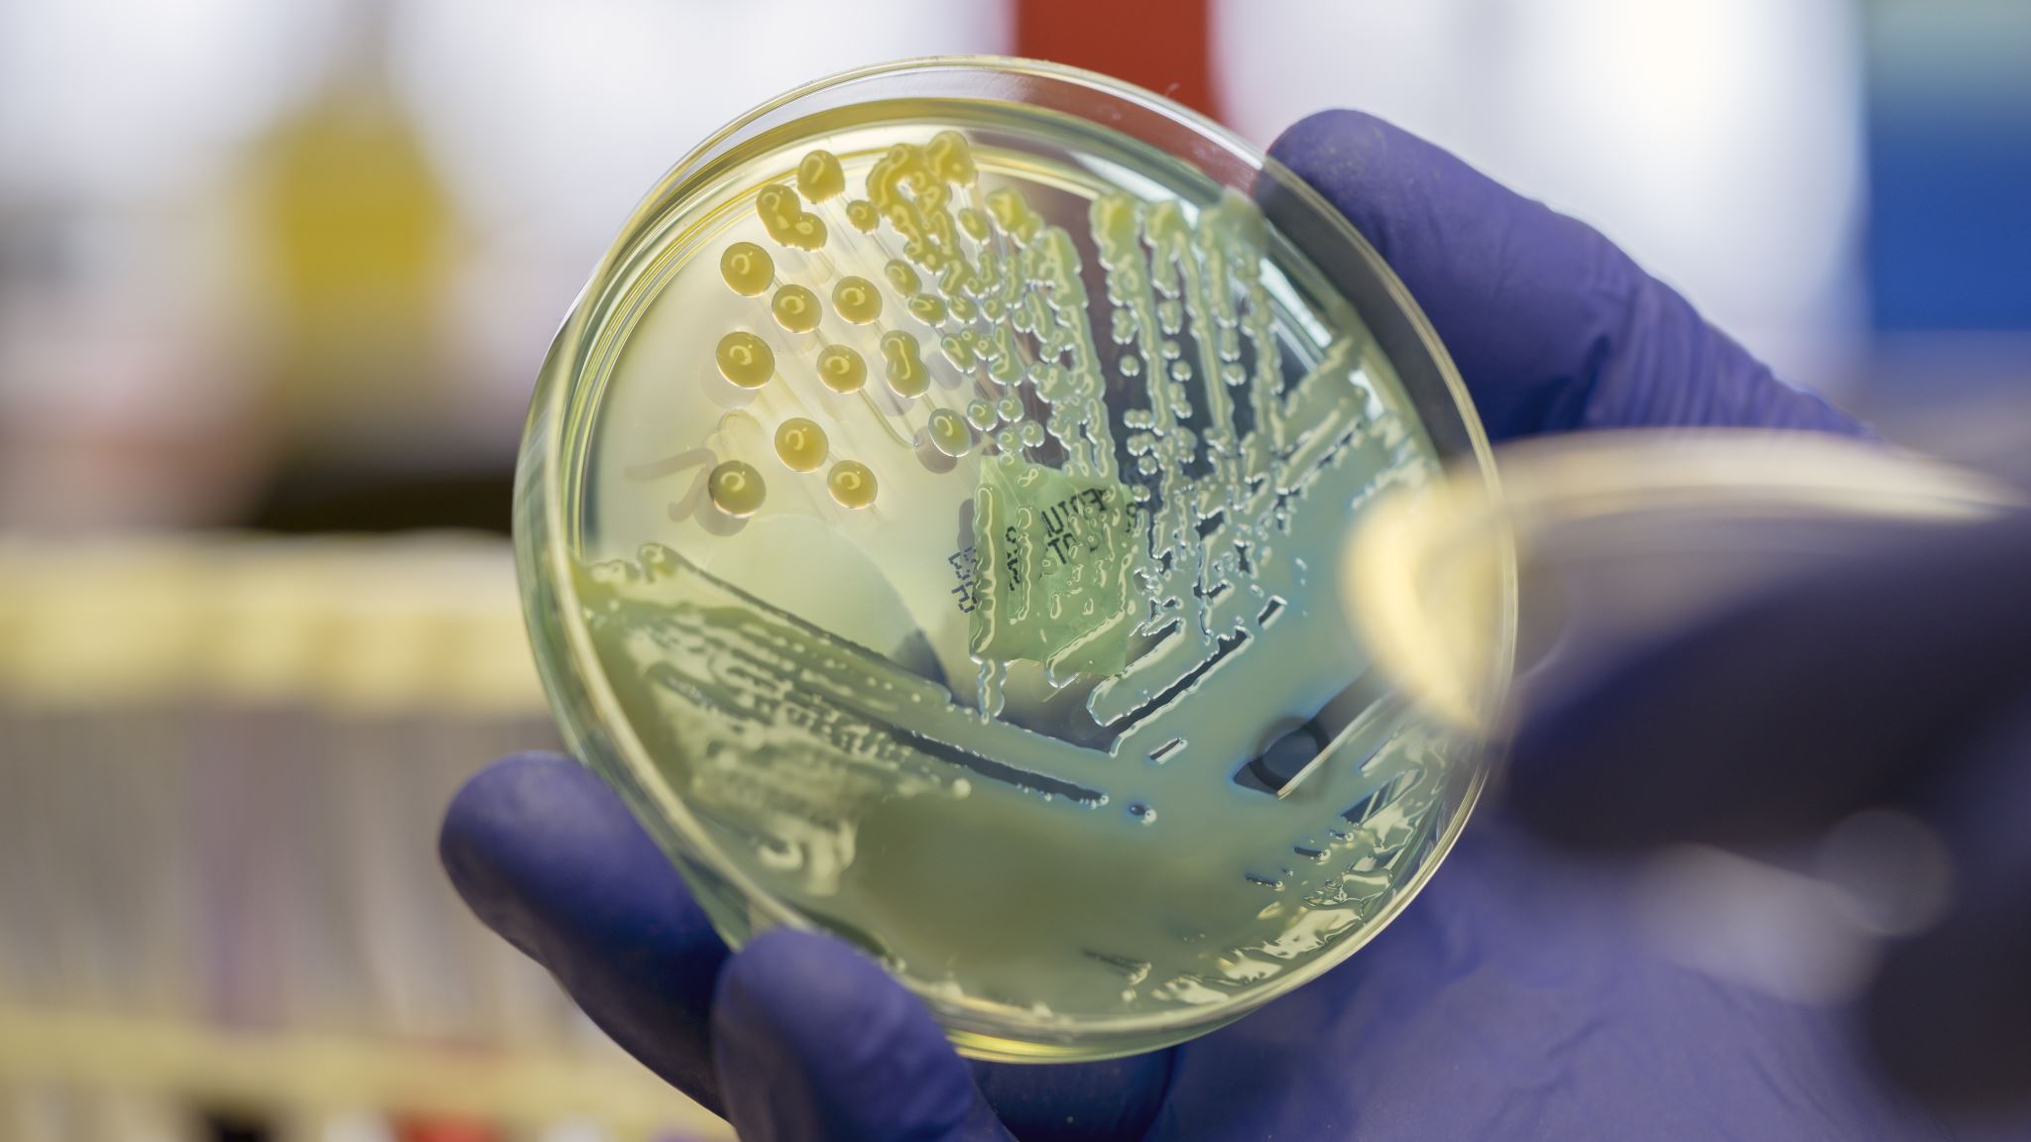
Background on F. tularensis RBC invasion
Can invade mouse RBCs
Horzempa et al. discovered F. tularensis can invade human RBCs, even though humans are incidental host
Invasion of RBCs helps F. tularensis survive in the gut of arthropods
Can cause disease 100 different species
  Can F. tularensis invade the RBCs of all the species?
How does F. tularensis invade RBCs?
Notes:
Few bacteria that can invade RBCs
Arthropods are vector
Two questions are related. If it can invade some species, but not others, we can look for differences in RBCs to understand what factors on RBCs lead to invasion
Reason we are stiyign different animals is to study how francella inveades RBCs, if we can find an animal tht doesn’t support invasion, look for differences, and better understand the molecules francella uses to invade the cells. So we got blood from differne tanimals, contact farms and research institution and get blood from animals—sheep, cow chicken. Hard to get. See if francella can invade sheep and cannot blood cow blood. Set it up, then show data. Make interesting, and set up slide before next slide.
Instead of this, talk about how we use human RBCs for experiments. F. tularensis can invade mouse RBCs. Humans are accidental host. Francella can infect over 100 differne ttypes of animals, but can ghey invade all RBCs, and we can compare the RBCs of aminals it can and cannot invade, we can learn about the mechanism of invasion.
Replace this slide with a translagtional slide. We know it invades human RBCs, but humans ar enot natural reservoid of fralcella—rodens and hairs are. F. can invade mouse cells, in vivo and invitro. Francella infect hundreds of animals. Can franells invade the RBCs of those animals? Andwe provides insight into RBC invasion.

Slide 4
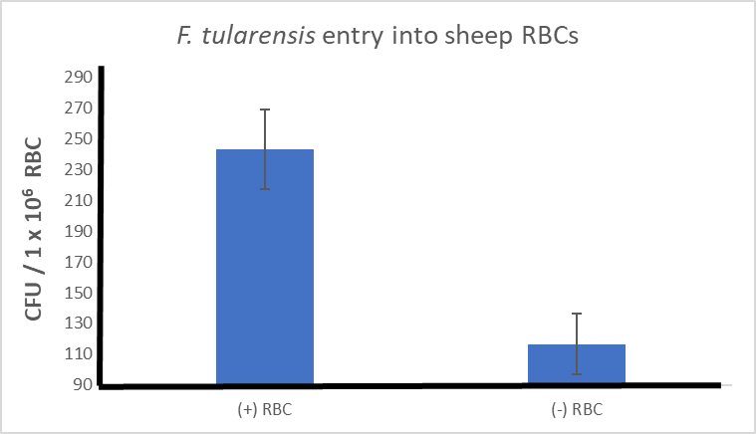
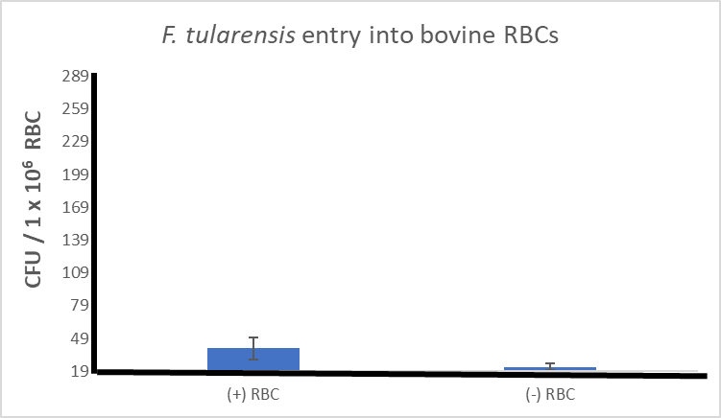
F. tularensis invades sheep RBCs but not bovine
Gentamicin protection assay
Notes:
Set up experiment first. Talk about gentamycin protection assay first, tell audience how we did experiment first. Bovine RBCs have a key difference compared to human RBCs.
Cannot do endocytosis
Change name to sheep, not lamb. Fonts to be bigger, line on X and Y axis. Dark line on X and Y axis, bold fonts, no horozintal lines. Like in the paper by Schmitt, horzempa. + and – RBCs. Cut off the background, and put background corrected invasion. Remove 120 from the Y axis. 20 to 160. Error bars: standard erros of the mean. Minus background from each well, and then figure out standard error. Remove mean background from each well, get new n and cakculat mean and standard erros of the mean.
Put take-home message into title.

Slide 5
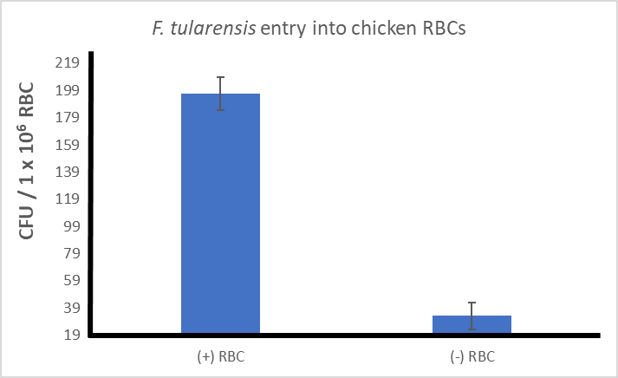
F. tularensis invades chicken RBCs
Gentamicin protection assay
Active invasion or via endocytosis?
Notes:
Endocytosis. Sought to test why Francella enters chicken: due to active invasion, or RBC endocytosis. Bovine/sheep/human RBC cannot do endocytosis—in those cases we know that Francella invades b/c active entry
X axis on chicken graph. Tested two difernet mallmes, francella invades sheep, not bovine. RBCs have nuclei. Point to pics, and chicken RBCs can do endocytosis. So we wanted to investigate this further, we know that surface proteins areivnovled, as well as type VI is involved. Can mention endocytosis somewhere. Put together in a fluid, flowing manners.
Use pointer to explain images, put some labels, fluroscentially lavbeled francella, just make cheal that fluroscentlly labeled francella, and we can see them indie the chicken RBCs. Label. Colony forming units 1X10^6 RBC, change.

Slide 6
Invasion of chicken RBCs is dependent upon Erythrocyte Surface Membrane proteins and the Type VI Secretion System
LVS + Chicken RBCs treated with Proteinase K
IglC-null LVS + Untreated Chicken RBCs
Same observation in human RBCs
Notes:
Why it enters chicken RBCs? Due to active invasion by francella. Previous studies, human RBC
Francwlla uses a RBC surface protein to invade
Type IV in francella is required to invade. Same for humans, for both proteinase K and IglC. Previous Horzempa studies. Chicken and human RBCs require same mechanism of invasion
Proteinase pronounciation. Before switch to next slide, summarize good data on chicken RBCs, type IV, chicken RBC surface proteins. If you can remember back a few slides ago, cow RBCs cannot support invasion, but sheep can. Want to find out why. Then next slide.
Take audience through pictures. In previous pic I showed you chicken RBC being invaded,here we can see mothing inside the RBC, and when we remove tye VI secretion system, remove invasion. When we treat with proteinast K, the protein-protein interaction between bacteria and RBCs, requires proteins from RBCs, and molecular machinery from francella.
Iglc-null. Both copies of the gene have
potentiall,y, a similar mechanism to what we see in humans.
IglCl is part of the type IV. Mgla is a transcription factor.
This is what we see in humans, so we can use chicken RBCs as a model for human RBCs.

Slide 7
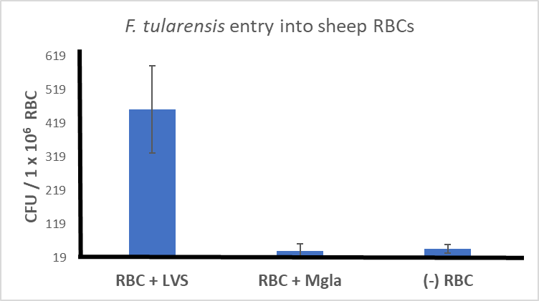
F. tularensis invasion of sheep RBCs is dependent upon Type VI Secretion System
Type VI secretion system required to invade human, chicken, and sheep RBCs
Notes:
Mgla strain does not have type IV. Type IV for humans, chicken, and sheep. This is what Francella requires to invade RBCs.
Next question: What on the RBC is required for invasion. Recall that treating with proteinase K prevents invasion. So something on RBC required for invasion.

Slide 8
What RBC surface protein(s) are required for invasion?
Horzempa lab
Human RBCs
Pseudechis guttatus (blue-bellied black snake) venom binds to Band 3 which disrupts spectrin filament architecture
Suggests that spectrin and/or Band 3 is involved
Schmitt et al, 2017
Notes:
Next question: What RBC surface protein(s) are required for invasion? Recall that treating with proteinase K prevents invasion. So something on RBC that Francella needs to invade.
RBCs treated with this venom binds/blocks band 3
Addition of Pseudechis guttatus (blue-bellied black snake) venom reduces invasion of HUMAN erythrocytes by F. tularensis.
Erythrocytes were treated with 25μg/mL P. guttatus venom for 20 minutes prior to infection (MOI of 12). Bacteria were co-incubated with the erythrocytes and were subjected to gentamicin protection assay to measure invasion. (B) To test whether altered membrane fluidics were not responsible for the decreased invasion observed in panel A, erythrocytes were treated with 50 μg/mL mitoxantrone for 30 minutes prior to infection and were subjected to gentamicin protection assay. Wells lacking erythrocytes served as controls.
This venom disrupts spectrin filament architecture by binding to Band 3, an erythrocyte membrane protein.
Blue belly black snake venom binds to band 3, and band 3 gets conformational change in cytosol, so band 3 or spectrin involved.
Then see surface protein is involved in invasion, b/c of the protease.
Only show one experiment where controls work. RBC see invasion, but media see no invasion.

Slide 9
Structural differences in erythrocyte Band 3 protein may be responsible for differences in RBC invasion
Notes:
Found old paper suggesting differences in band 3in cow and human. Focus on Band 3. Compared amino acid sequence here, humans, sheep, chicken, bovine.
Google: Glycosylation of bovine vs human band 3. this is what the paper suggests.
Include snake venom data too.

Slide 10
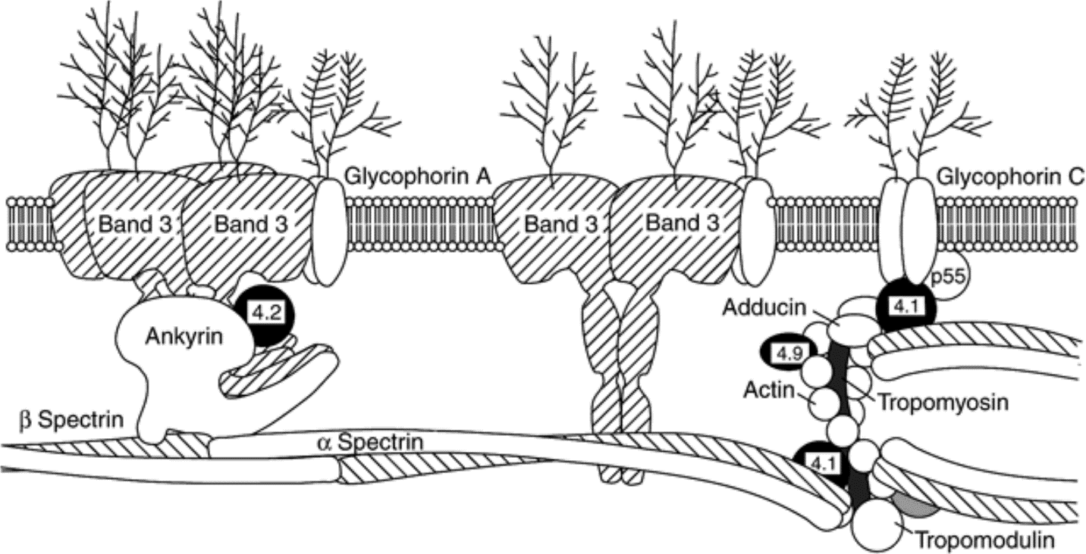
Band 3 is the focus of our study
How do we study if Band 3 is involved?
Notes:
Different glycans
Band 3 is a glycoprotein. Band 3hard out attention for years, as band 3 interacts with spectrin, so changing cytoskeletal arrangement is important for entering bacterial hsot cells. Next slide.
Glycoprotein
From previous two studies, saw the Band 3 or spectrin is involved. For my project, only focus on Band 3, b/c its on the membrane.

Slide 11
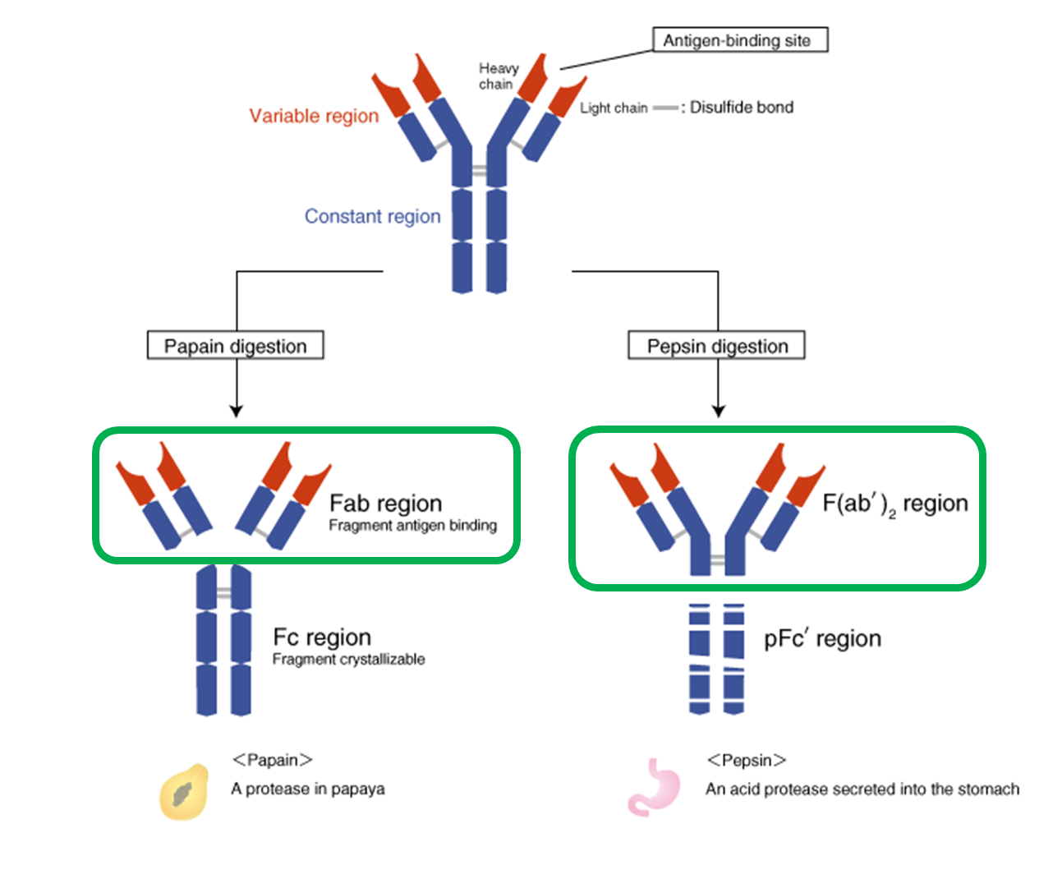
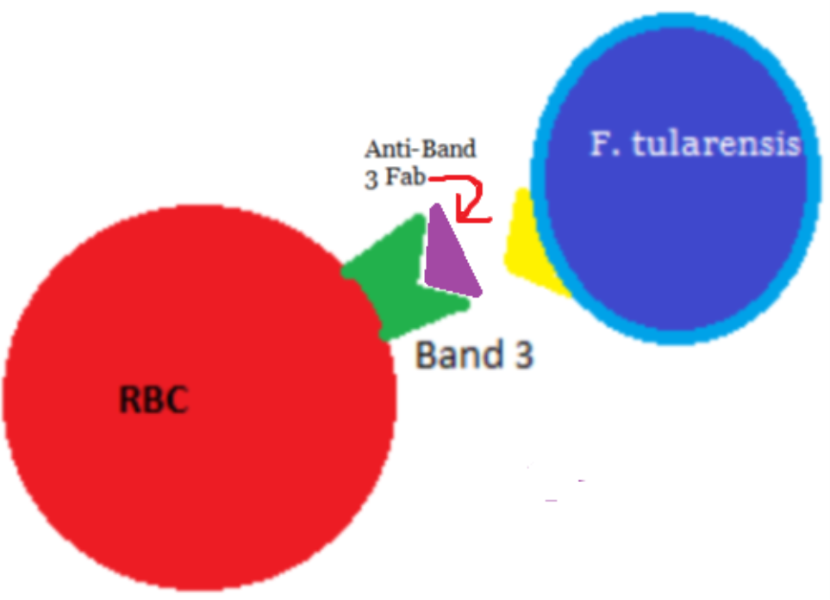
Does blocking Band 3 prevent invasion?
Notes:
How do we study if Band 3 is involved? If it does prevent invasion, means that Band 3 is involved. If it does not prevent invasion, Band 3 is not involved.
How we study Band 3: Block band 3 and see if that impacts invasion
Serum from species required for invasion. Using antibodies leads to complement activation and cell lysis.
Fc region as an experimental control
Fab is the antigen binding region of the antibody. Explain why we want the antigen-binding region. These antibodes activate complement, which is in serum. And RBC invasion does not occur in presense of complement in serum, activates RBCs. Explain why we want Fab fragments.

Slide 12
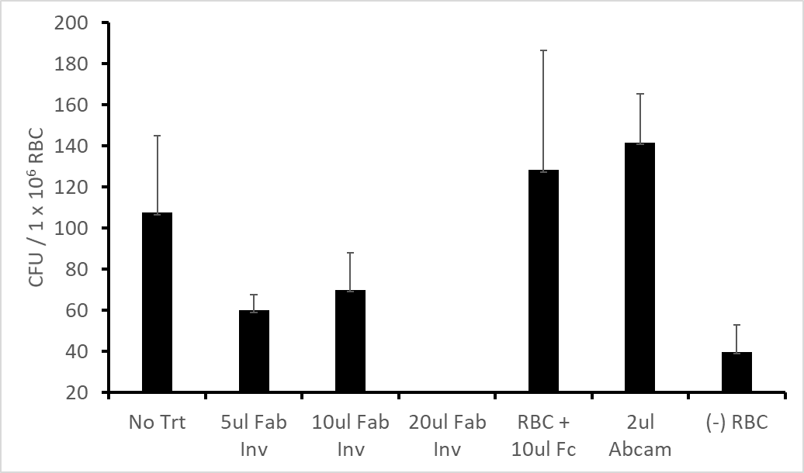
Blocking Band 3 appears to inhibit invasion: Preliminary results
Human RBCs
Gentamicin
protection assay
Notes:
Need to repeat this. Walk through this.
RBC media control, change to (-) RBC. Change to (+) RBC, and (-) RBC, control without any RBCs. Fc offers no protection, but Fab does
Emphasize that is is preliminary, just getting started. Hard time getting Fab fragments, cannot get enough antibody from commercial sources.
Change bottom to 20.

Slide 13
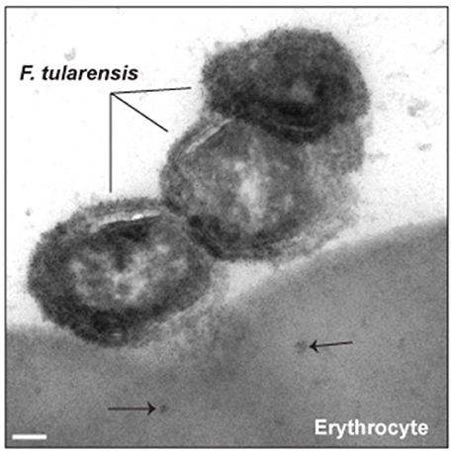
Does F. tularensis form distinctive aggregations on RBCs?
Observed possible unique bacterial aggregations in fluorescent microscopy imaging.
Random or active?
Schmitt et al, 2017
Notes:
Maybe a random coincidence or maybe actively forms pattern. Actively engaging with each other?
Cite the picture, from same paper as venom.
Reference where we got picture from. Here we can see one francella cell in process of invading, and it looks like two other cells are interacting with it. Maybe some bacterial aggregration, bacterial-cell interaction. “bacterial cell-cell interaction” or “bacterial-aggregration”, NOT pattern. So if one starts interacting with RBCs, some other mechanism allows to recruit more bactiera to site. Bugs aggregrating some how, and it appears to be protein-mediated.
Next slide, “here is an example, can see an aggregration of bacteria, but when we treat it, we don’t see as much aggregration, or cell-cel interaction”. Interaction with RBCs might be promoting these aggregations. Remove proteins from RBCs, see less aggregration
We are working on Band 3, along the way, we saw a very unique pattern. Picture of francella intering with band 3, and a question mark.

Slide 14
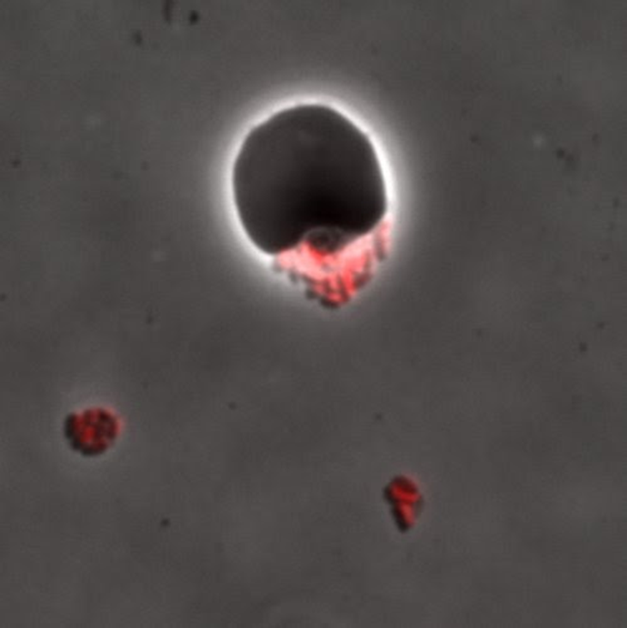
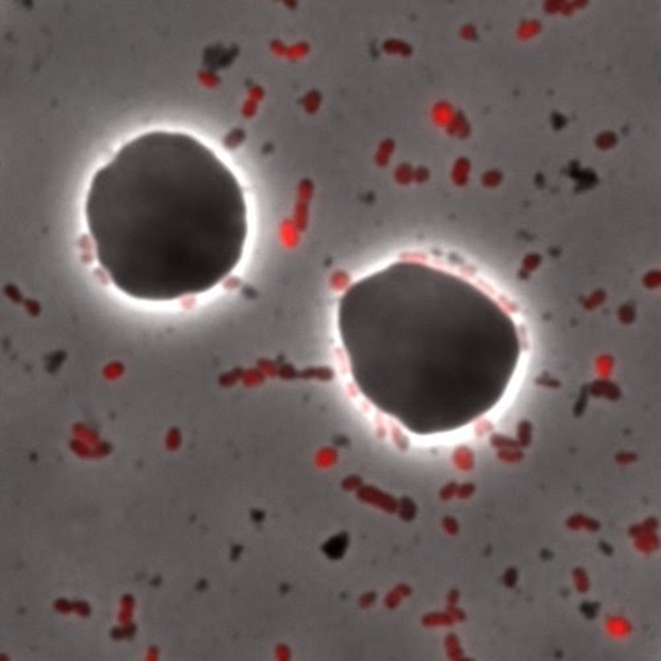
Aggregation prevented in human RBCs treated with Proteinase K
F. tularensis in untreated RBCs
F. tularensis in RBCs treated with Proteinase K
Suggests RBC surface protein(s) contributes to aggregation
Notes:
Proteinase K prevents invasion by removing the surface protein. Something on the RBC surface contributes to francella aggregation.
Proteinase K abolishes aggregation change title. Practice a lot more. Look into the camera. Imagine that audience is behind cameria.
This is where we treat the blood cells.
Transition slide before this saying how we have been doing microscopy.

Slide 15
Fixing F. tularensis prevents aggregation in human RBCs
Untreated F. tularensis
Fixed F. tularensis
Suggests not a random aggregation
Notes:
Possible of randomness. Glutaraldehyde. Not random. Very difficult to quantify this, random motion, especially when we put on slide.
Aggregration abolished in fixed cells.
Fixed=dead. glutaraldehyde, don’t have to explain furhur, don’t say dead.
This is where we kill the bugs. Somehing is happening that they are able to aggregate even though they don’t directly touch RBCs.
Find a different picture fo untreated. Show quantification too, in graph form.

Slide 16
Attempt to quantify F. tularensis aggregation with human RBCs
Condition | Average # on RBC | # RBCs counted | # Aggregates
Untreated RBCs | 9.203 | 60 | 13
RBCs treated with Proteinase K | 7.763 | 113 | 4
Notes:
Blinded, randomized, unlabeled. Early stage. Untreated RBC had increased number of francells aggregates. Something on RBC contributes to francella aggregation.
Combine data into one table and show one table.
Move through slides quickly,

Slide 17
Summary: Preliminary Evidence
F. tularensis can enter the RBCs of chicken and sheep; cannot enter bovine RBCs
  Active invasion in chicken RBCs (not endocytosis)
Invasion requires RBC surface protein(s) and the Type VI secretion system
Band 3 appears to be involved in invasion
F. tularensis forms aggregations on RBCs
  Appears to depend on RBC surface protein(s), do not appear to be random

Slide 18
Future studies
Different species
Comparison of amino acid sequence and structure of Band 3 in different species
  Consider other RBC differences as well
Additional studies into RBCs treated with Proteinase K and anti-Band 3 Fab
Studies of IglC-null and Mgla in different species (Type IV secretion system)
Quantification of aggregation
Notes:
Different species, different band 3 and if that correlates with invasion. Look for other RBC differences as well.
Proteinase K anti-Band 3 Fab to study how different species interact with RBCs.

Slide 19

Acknowledgments
Dr. Joseph Horzempa, Ph.D
Dr. Stuart Cantlay, Ph.D
Dr. Deanna Schmitt, Ph.D
Kristen Haggerty, M.S.
This study was funded by the National Institute of Allergy and Infectious Diseases (1R15HL147135) and an Institutional Development Award (IDeA) from the National Institute of General Medical Sciences of the National Institutes of Health (P20GM103434), which funds WV-INBRE program.
Notes:
Cite fundining. In abstract.

